Slide 1

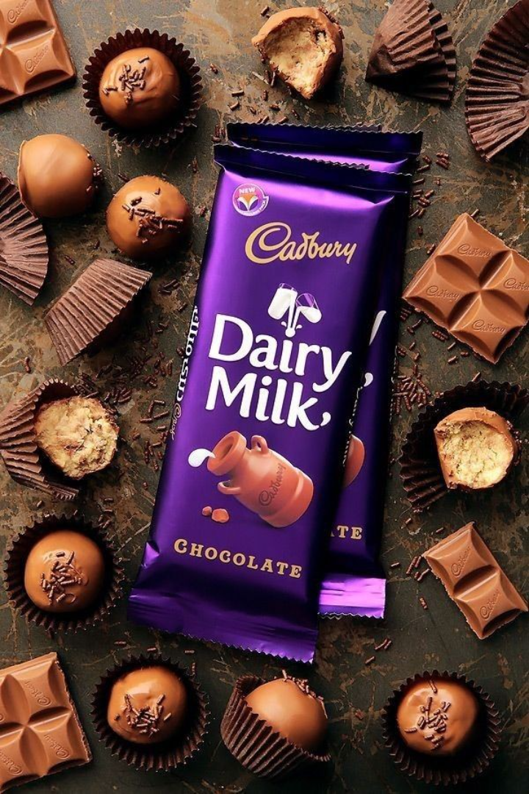
The Art of Sweet Seduction: Cadbury's Marketing Mastery Unveiled
KUCH MEETHA HO JAAYE !

Slide 2

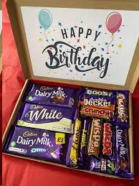
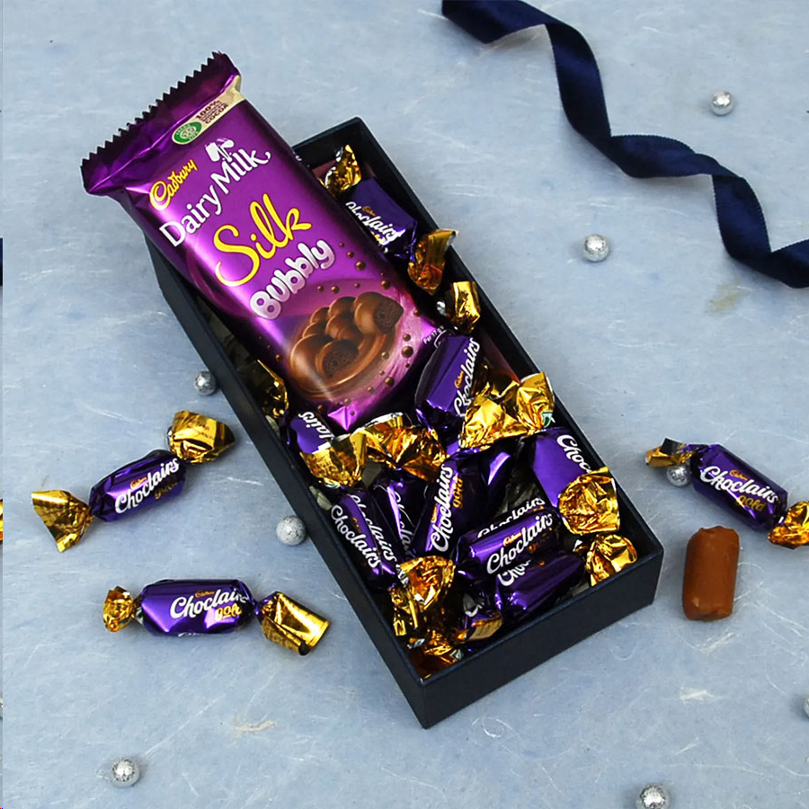
Introduction to Cadbury
1.
A Sweet Legacy 🍫
Cadbury, a legendary chocolate brand, has been delighting taste buds since 1824 with its delectable confections.
2.
The Essence of Joy
Known for its iconic purple packaging and irresistible taste, Cadbury remains synonymous with happiness and indulgence.

Slide 3
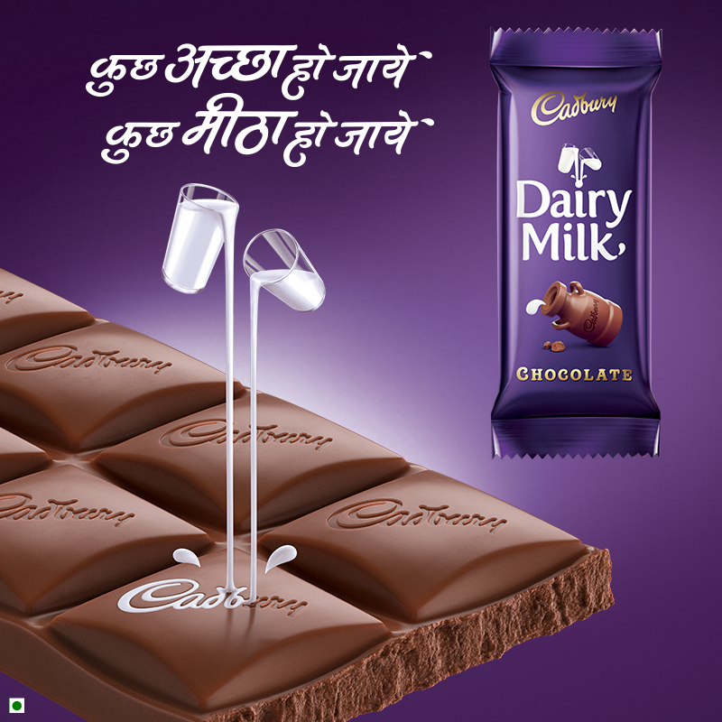
The Power of a Tagline
Cadbury's catchy tagline encapsulates its mission to liberate joy and create moments of delightful indulgence for people worldwide.

Slide 4
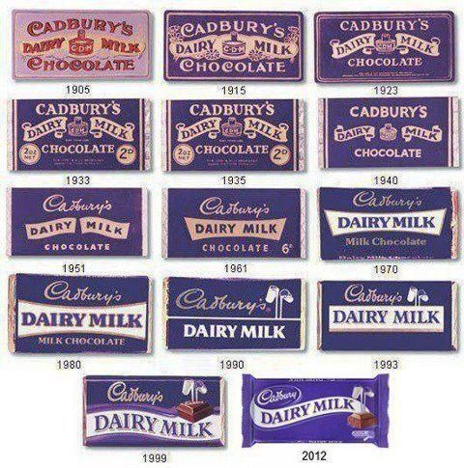
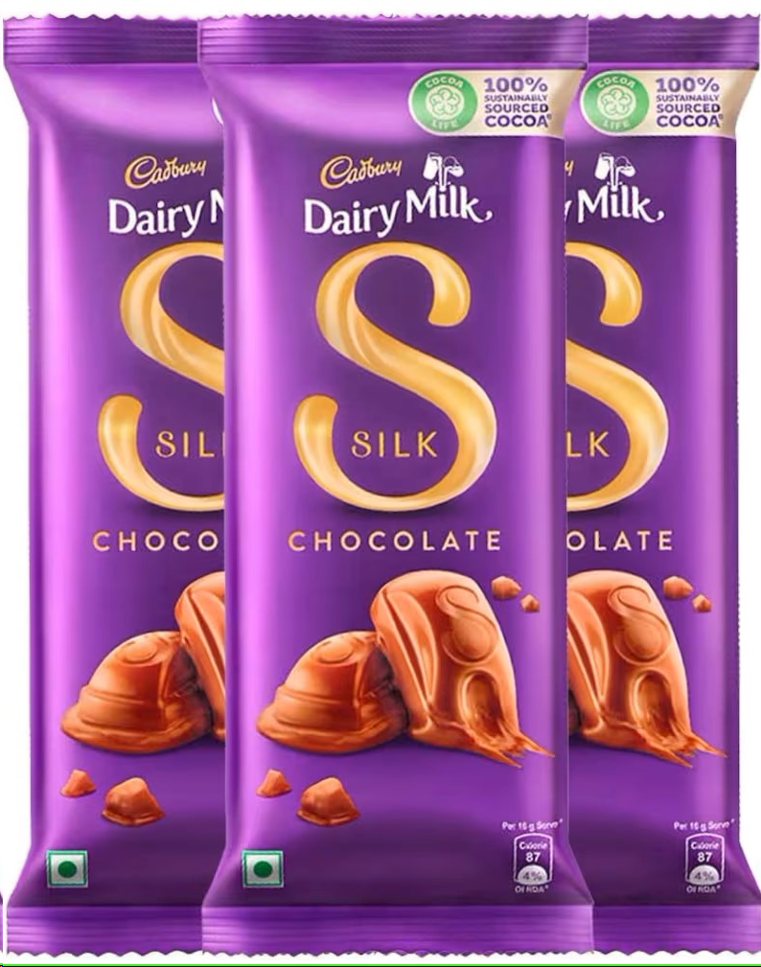
CHANGES IN AD - PAST TO PRESENT
2020s

Slide 5
Target Audience
Cadbury's diverse range of confections appeals to individuals of all ages, from children enchanted by Dairy Milk to adults craving a nostalgic treat.

Slide 6
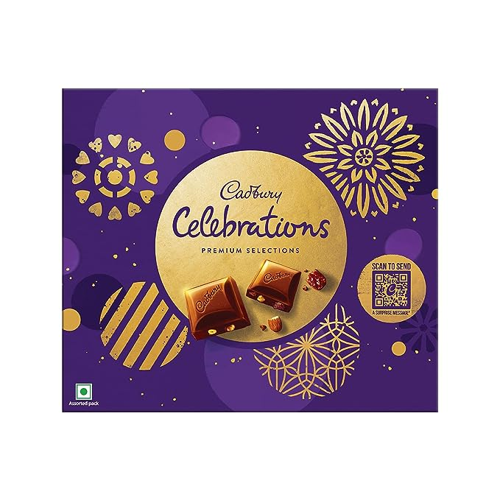


Creative Advertising Campaigns
1
Moment of Joy
Cadbury's "Joyville" campaign immersed audiences in a magical world where chocolate brought extraordinary moments of pure joy.
2
Gorilla's Groove
The unforgettable "Cadbury Gorilla" commercial captivated viewers with a gorilla passionately drumming to Phil Collins' "In the Air Tonight."
3
Endearing Advent Calendar
Cadbury's advent calendar commercials evoked anticipation and childhood wonder, beautifully illustrating the joy of counting down the days until Christmas.

Slide 7

Strategies that Spell Success
Emotional Storytelling
Cadbury leverages emotion to create authentic connections, weaving heartwarming narratives that resonate deeply with consumers.
Innovative Product Extensions
Cadbury constantly reinvents itself, introducing new flavors, textures, and packaging formats that keep consumers hooked on their beloved treats.
Engaging Social Media Presence
Cadbury's captivating social media content, influencer collaborations, and interactive campaigns foster strong brand loyalty and engagement.

Slide 8

Triumphant Feats and Learning from Failures
1
Fruitful Collaborations
Cadbury's partnership with Oreo produced the immensely popular Cadbury Dairy Milk Oreo, a brilliant marriage of two iconic treats.
2
Missteps and Lessons
The ill-received "Attempts to Audition" campaign taught Cadbury the importance of diversity and culturally sensitive storytelling.

Slide 9
Shaping Consumer Behavior
Craving-Inducing Ads
Building Emotional Bonds
Cadbury's mouthwatering advertisements have a subconscious impact, leaving consumers with an irresistible urge to satisfy their chocolate cravings.
Through heartfelt storytelling and relatable characters, Cadbury forges emotional connections, making their chocolates a familiar companion in times of joy and comfort.

Slide 10
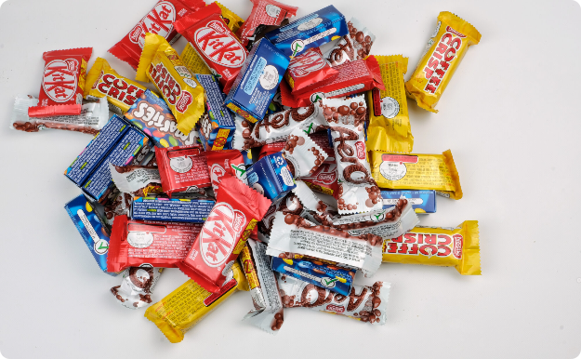
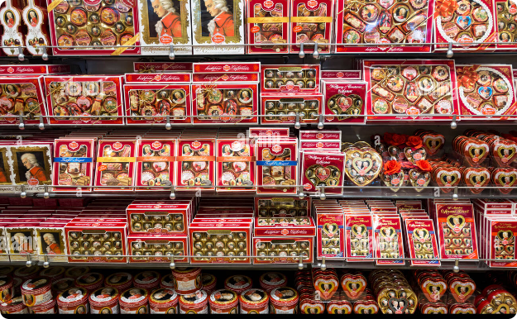
Market Competition: A Chocolate Showdown
Top Contenders
Standout Strategies
Cadbury faces fierce competition from renowned chocolate brands such as Lindt, Hershey's, Godiva, and Nestlé in the race to cater to consumers' sweet tooth.
Cadbury's strategic innovation and emotional resonance enable it to remain a prominent player in an ever-evolving and fiercely competitive chocolate market.

Slide 11

Conclusion and Key Takeaways
1
Unleashing Joy, One Bite at a Time
2
Lessons for Success
Cadbury's dedication to bringing joy through their delectable treats and memorable campaigns has solidified its position as a beloved chocolatier.
Cadbury's marketing journey teaches us the power of storytelling, emotional connections, and continuous innovation in capturing consumers' hearts and taste buds.

